Slide 1
How Speakers
Find PAID Events!
…helping speakers develop a successful speaking business

Slide 2
Events

Slide 3
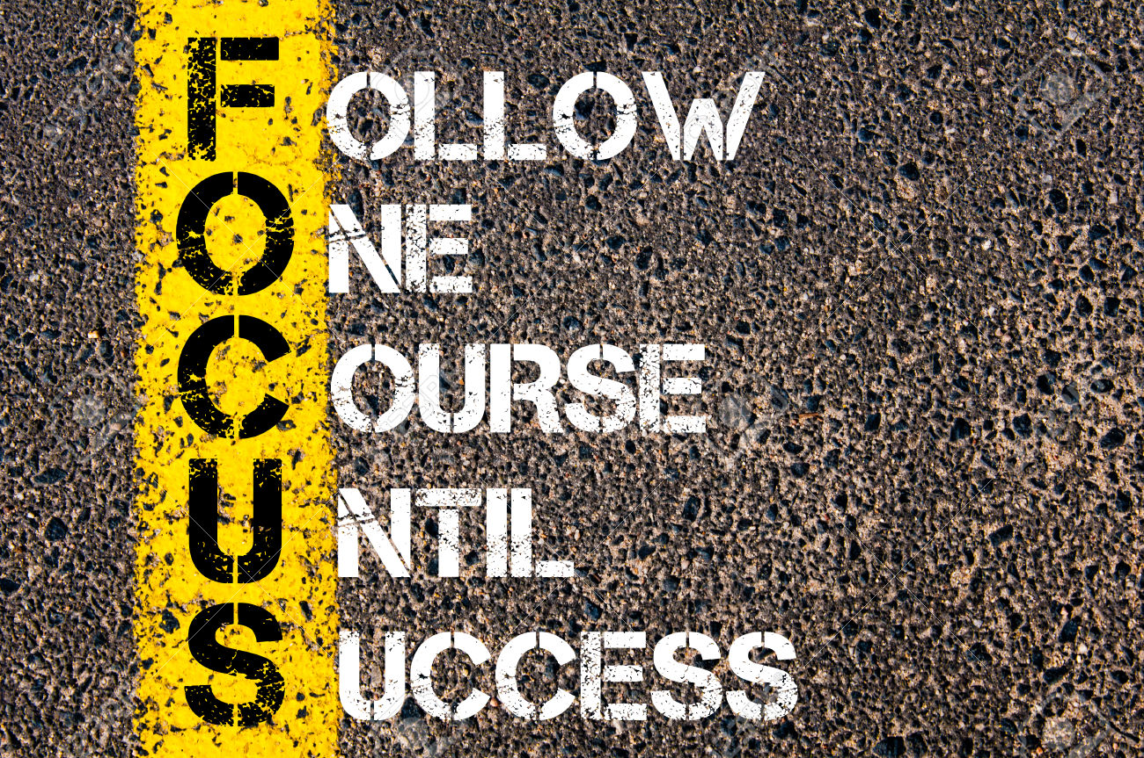

Slide 4
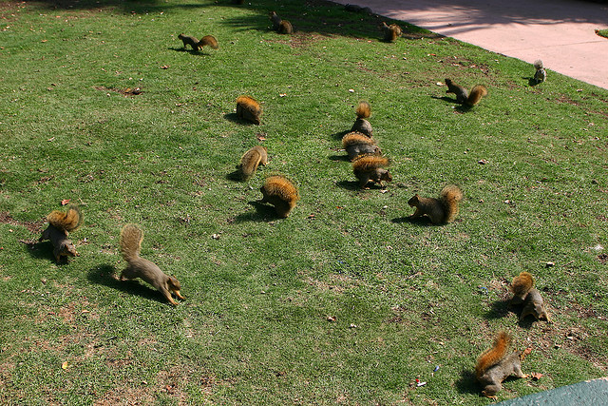

Slide 7
Your program

Slide 10
Industry
Conferences
Chapters
Association

Slide 11
?
?
?
?

Slide 12
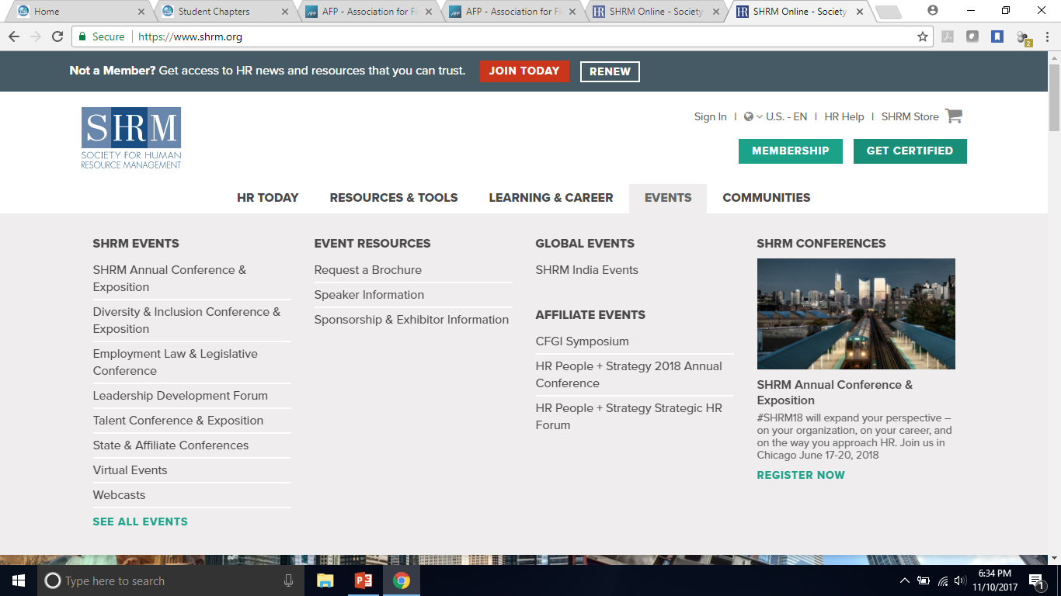

Slide 13
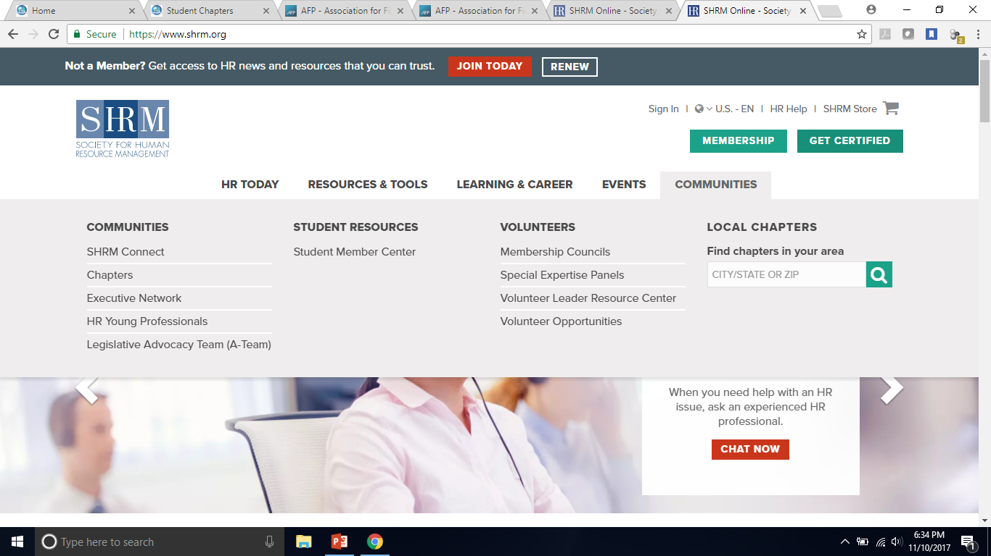

Slide 17
@KevinCSnyder
KevinCSnyder.com
PAIDtoSPEAK.BIZ
Order from Passion Project and your book will be autographed. You’ll also receive a complimentary 30-minute coaching call!

